Slide 1
Microsoft Graph
Quick Summary

Slide 2
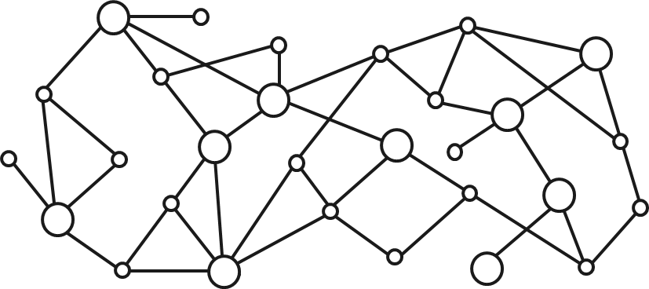
Gateway to your data in the Microsoft cloud
Your app
Web Apps
Device & Native
Apps
Bots
Background
processes
1
Gateway
Microsoft Graph
Office 365
Windows 10
Enterprise Mobility + Security
Your or your customer’s data
Microsoft identity
Rich content
Deep insights
Real-time updates

Slide 3
Microsoft Graph
https://graph.microsoft.com
ALL
your data across Microsoft 365
Office 365
Windows 10
EMS
ALL
types of users
Corporate (@contoso.com)
Consumer (@outlook.com)
Education (@myschool.com)
ONE
way to access it
One endpoint
One auth key
One set of docs
One SDK

Slide 4
Microsoft 365 Platform
Extend Microsoft 365 experiences
web, device, and service apps
Build your experience
Documents
Pages
Conversations
Timeline
iOS/Android/Windows/Web
1
Microsoft Graph

Slide 5
Opportunity
90%
Fortune 500 companies
have data in
Microsoft Graph
135M+
Monthly active users in
Office 365
1.1B
Identities authenticated
each month
65M+
Enterprise Mobility seat install base (+55% YoY)
181
Countries with Knowledge Workers using Office 365
1B+
Meetings scheduled each month with Office 365

Slide 6

Microsoft Graph Gateway to your data in the Microsoft cloud
https://graph.microsoft.com
Office 365
Windows 10
Enterprise Mobility + Security
Users, Groups, Organizations
Outlook
SharePoint
OneDrive
Teams
Planner
Excel
OneNote
Activities
Device Relay
Commands
Notifications
Azure AD
Intune
Identity Manager
Advanced Threat Analytics
Advanced Threat Protection
Dynamics 365
Financials
Mail, Calendar,
Contacts and Tasks
Sites and Lists
Drives and Files
Channels, Messages
Tasks and Plans
Spreadsheets
Notes, and more…
Identity Management
Access Control
Synchronization
Domains
Administrative Units
Applications and Devices
Advanced Threat Analytics
Advanced Threat Protection
Alerts
Policies
and more…

Slide 7







Microsoft Authentication Libraries (MSAL) – Up Next
Targeting GA by early spring:
JavaScript, AngularJS, .NET, UWP, Xamarin, Android, iOS
GA is quality driven, we need your feedback!
PREVIEW
PREVIEW
PREVIEW
PREVIEW
JavaScript
AngularJS
.NET
UWP
PREVIEW
PREVIEW
PREVIEW
Android
iOS
Xamarin

Slide 8
Business Process with Graph

Slide 9




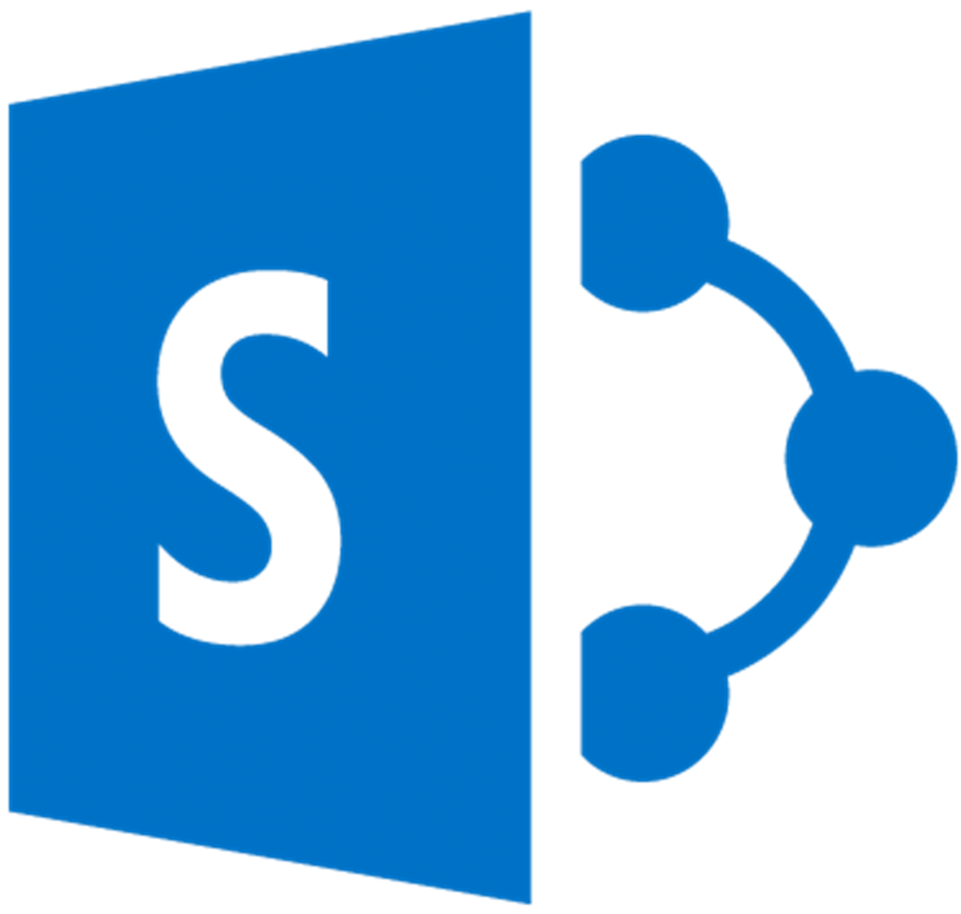






Contoso Airlines
Provision
Team
Flight change
notifications
Lock down
attendants
device

Slide 10

Use Microsoft Graph to streamline
Facilitating collaboration across entities
Managing employee lifecycle
Protecting sensitive data across devices
Responding to threats
… and MORE

Slide 11
Notification

Slide 12
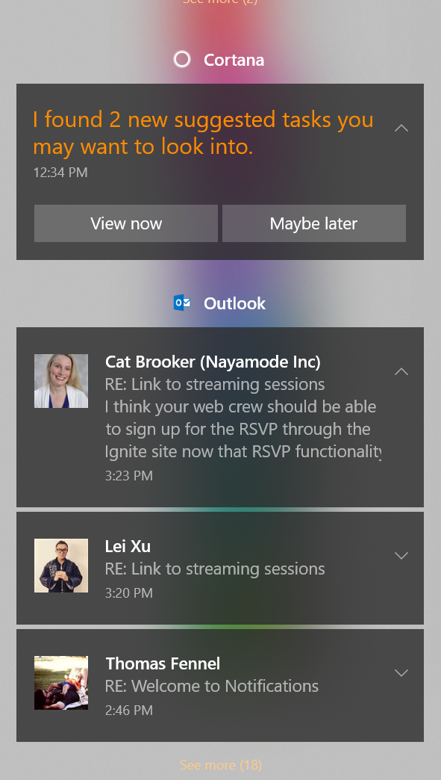
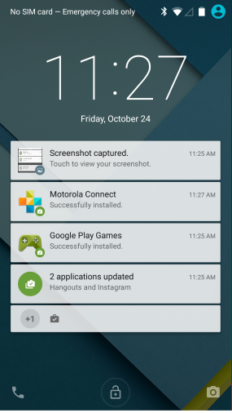
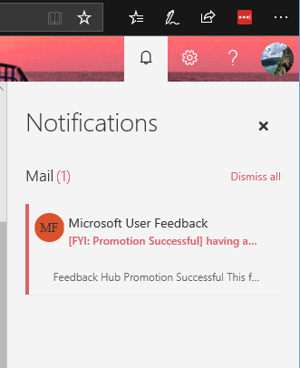
What are notifications?
Notifications are pieces of information originating from an app or a service targeted at the user
This Photo by Unknown Author is licensed under CC BY-SA
This Photo by Unknown Author is licensed under CC BY-SA
This Photo by Unknown Author is licensed under CC BY-SA

Slide 13
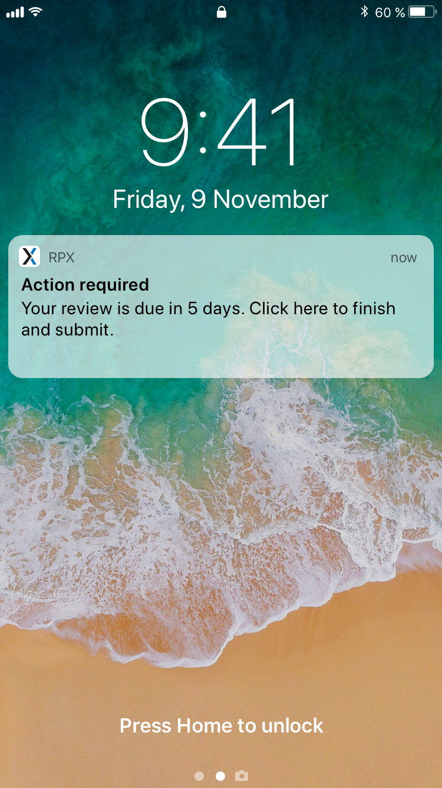
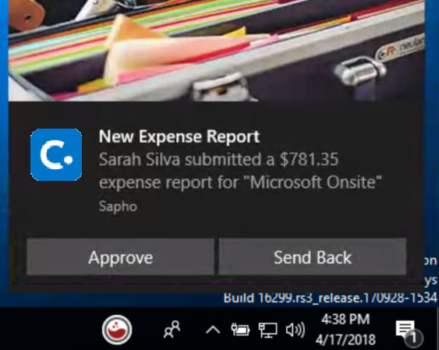
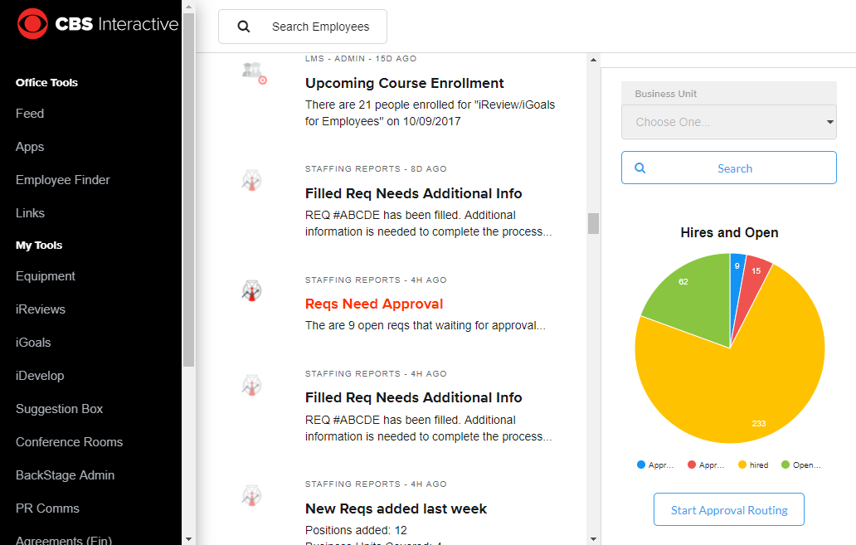
Notifications Drive Real Returns
Drive
Engagement
Decrease
Time to Action
Better Decisions
With Proactive BI
Improve
Employee Satisfaction
RPX Review Participation Grew 80% to 100% with Oracle Micro Apps
J&J Average Time to Approve
Concur Expense Report
Reduced from Days to Hours
Consumption of Power BI Data at Turner Increased from 20% to 100%
CBS IT’s NPS Went From Negative to Mid-40s with Notification-Driven Portal
Notes:
Emphasize the J&J scenario most

Slide 14
Thank You

Slide 15
Feedback - https://tinyurl.com/MelO365Bootcamp
Product | Link
SharePoint | https://github.com/sharepoint
Teams | https://docs.microsoft.com/en-us/microsoftteams/platform/samples/code-samples
Microsoft Graph | https://github.com/Microsoftgraph
Office Add-ins | https://github.com/OfficeDev/TrainingContent/tree/master/OfficeAddin
Outlook | https://github.com/jasonjoh

